Slide 1

Employment Now! Analysis
Yiming Ge
3/10/2020

Slide 2
General Data Summary
19.89 K
$9.83
63%
99%
19890 people (46% male & 54% female) from 65 different counties (55% from Brooklyn) participated in Employment Now! and 100% got employed.
The average hourly wage from these data is $9.83 higher than NYC 2013 minimum wage $7.25 but lower than NYC 2020 minimum wage $15.
The average days on job after participating this program are 1333 days (63% of people have a job tenure longer than 6 months)
99% of participants have high school degree (93%) or higher(6%)

Slide 3

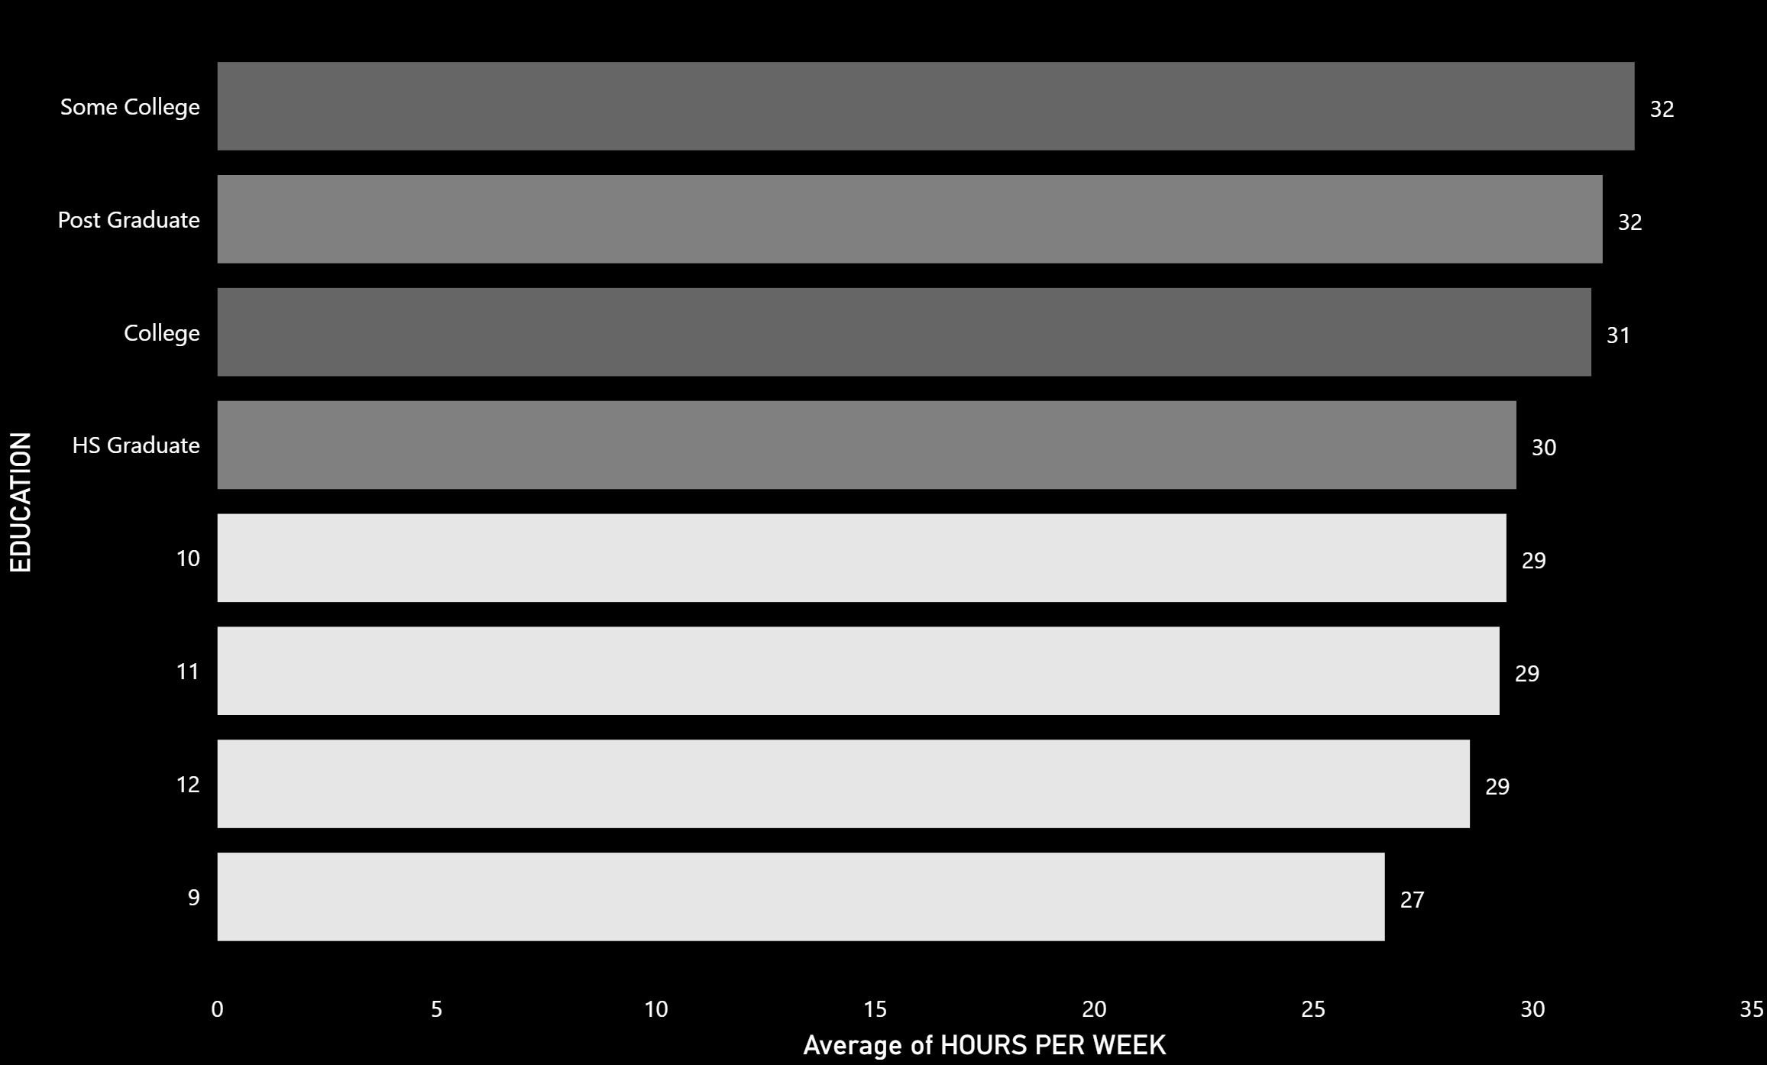


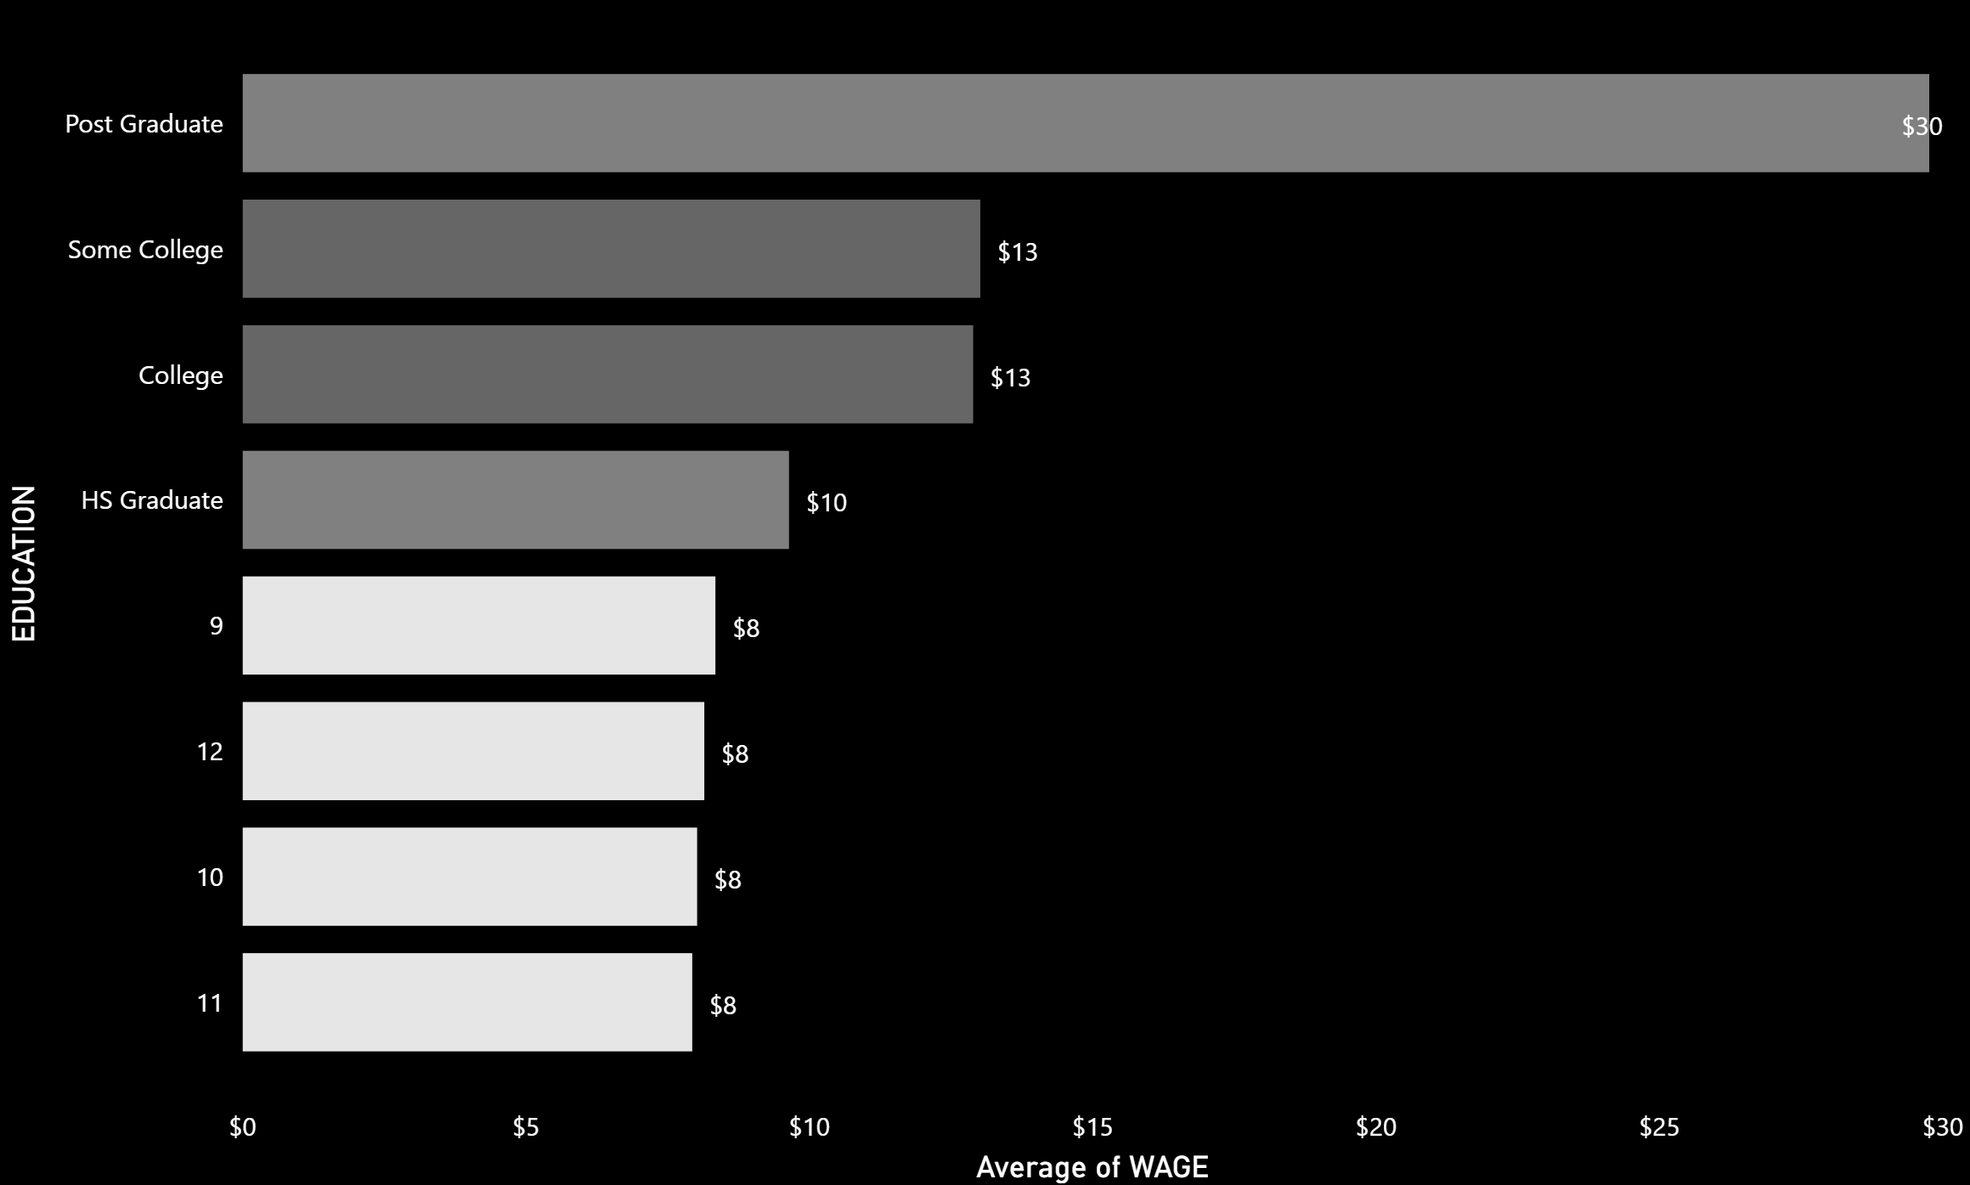

Education Level Analysis
People with high school degree or higher have more working hours per week than people with middle school degree.
College and higher
6%
High School
93%
Obviously, people with high school degree or higher (especially post graduate degree) have higher hourly wage than people with middle school degree.
Middle School
1%

Slide 4
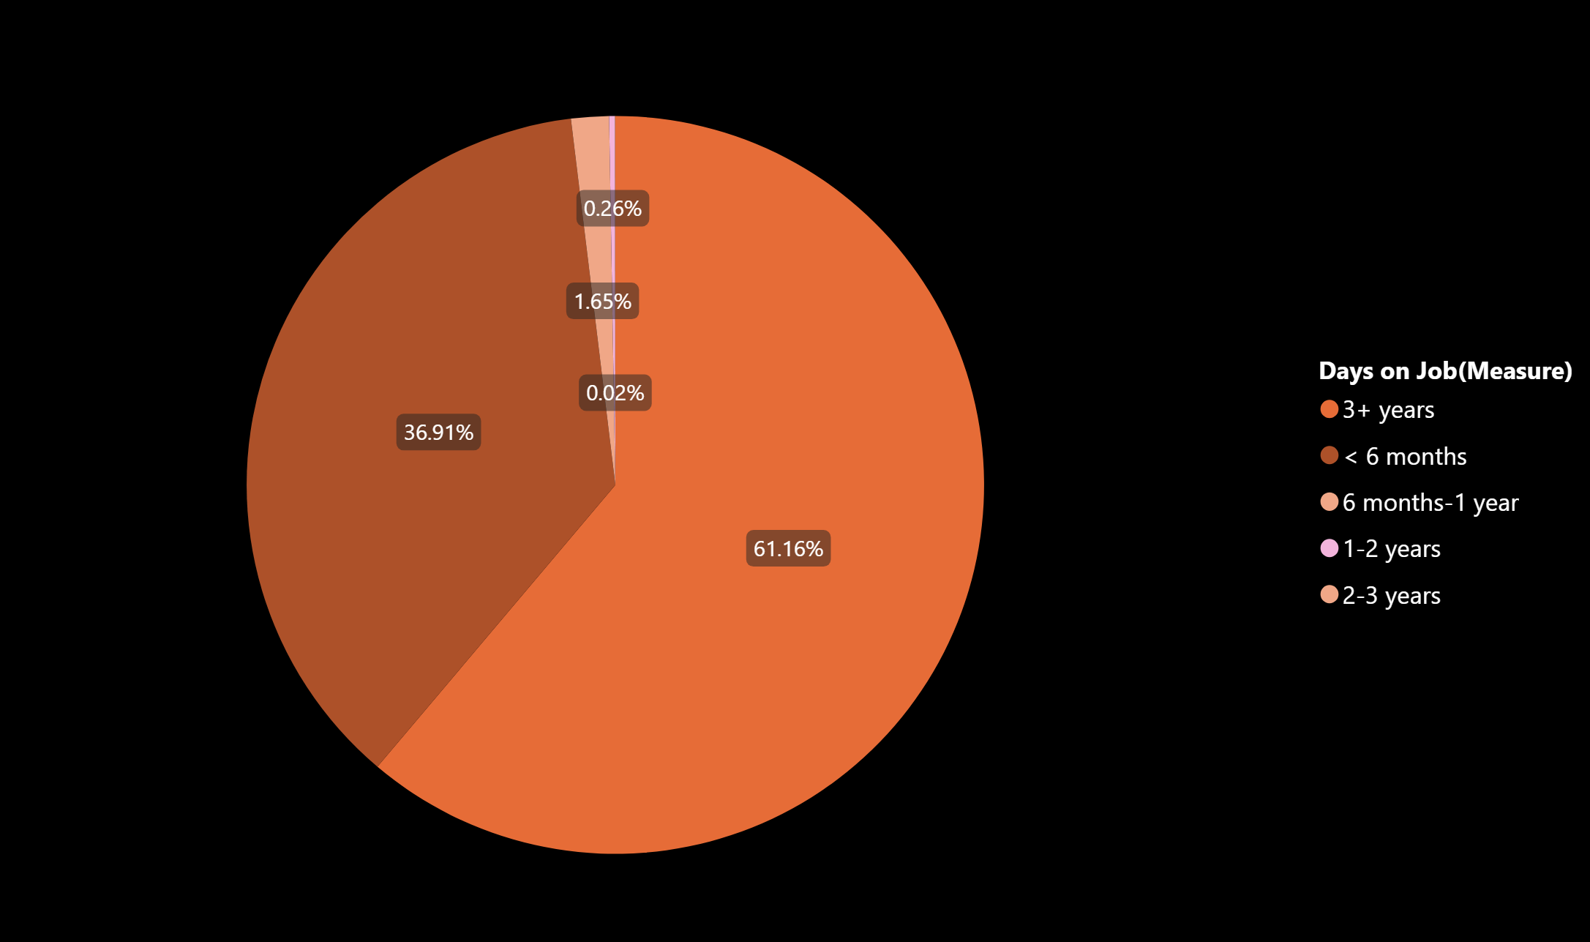
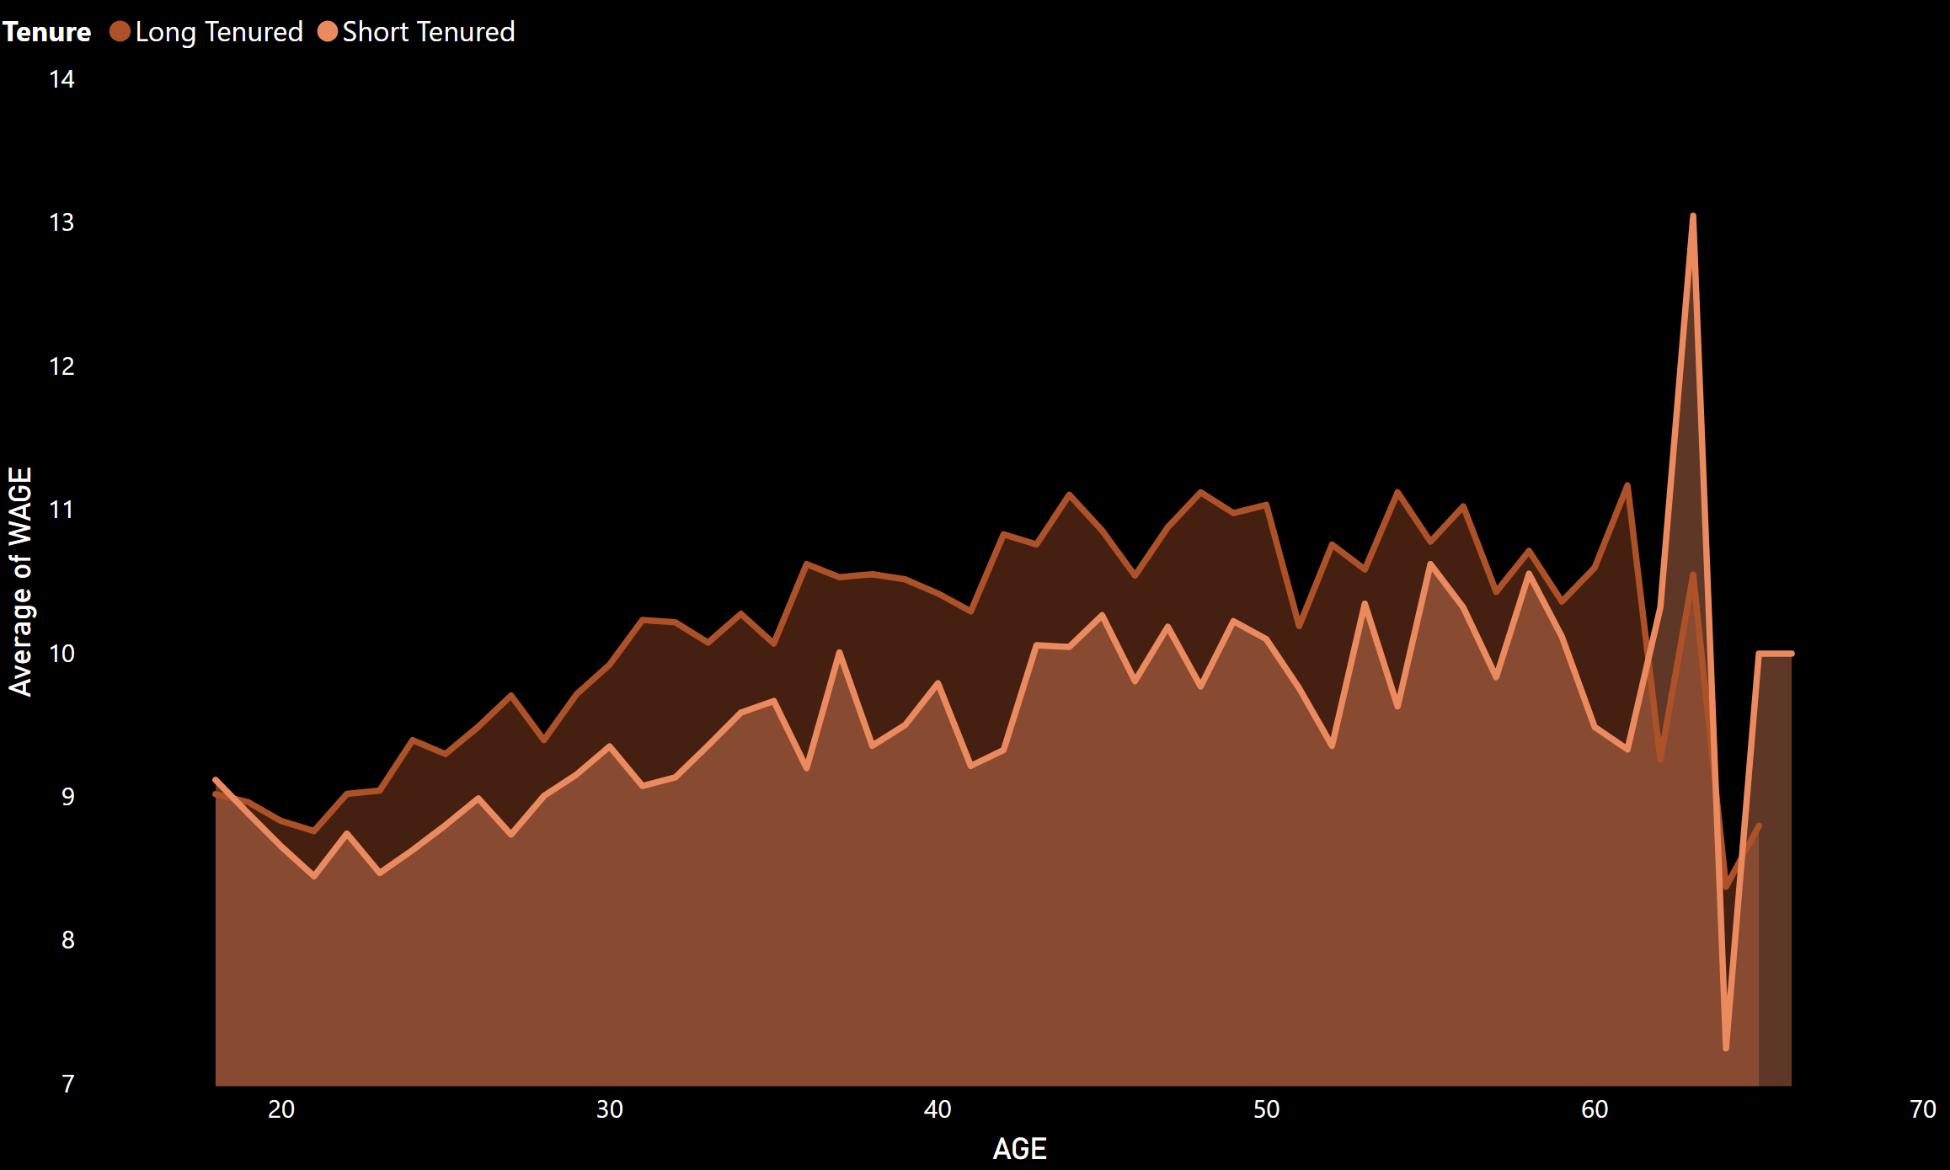
Tenure Analysis
63% of participants works more than 6 months (Long Tenure) and 37% of participants works less than 6 months (Short Tenure).
In most age groups, people with long tenure have higher hourly wages than people with short tenure

